Slide 1
Predictive Power in Language Encoding Models
RJ Antonello

Slide 2

Language Processing in the Brain
Notes:
So as a grad student, most of my research has focused on studying language processing in the brain, and by this, I mean the process whereby we as humans can get some auditory stimulus

Slide 3
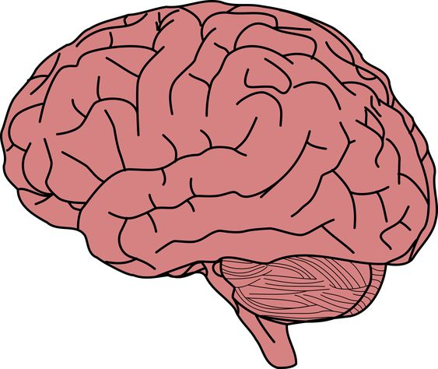

Language Processing in the Brain
Notes:
And have our brains perform some mysterious computation on that stimulus

Slide 4
Language Processing in the Brain
Neural
Response
Notes:
Which evokes some sort of neural response in us that is in someway meaningfully related to the stimulus. So, for instance, we might hear the sounds corresponding to the words “I reached over and secretly undid my seatbelt.” and we would perform this computation so that we discretize these sounds into words and then extract the semantic meaning of those words to evoke a neural response, which might manifest in the mental imagery of a person unbuckling their seatbelt.

Slide 5

Language Processing in the Brain
Neural
Response
Notes:
And it should be clear to all that this unknown computation that the brain performs is something that should be considered highly important to us both as scientists and as humans. If we were able to understand how the brain does this, it would naturally shed light on what it is that makes us unique in the animal kingdom, and would of course have innumerable applications in medicine, artificial intelligence research, education, and no doubt many other fields. So I’m probably preaching to the choir here, but it should be clear to everyone why this is a topic of extreme importance and something that is worth studying.

Slide 6
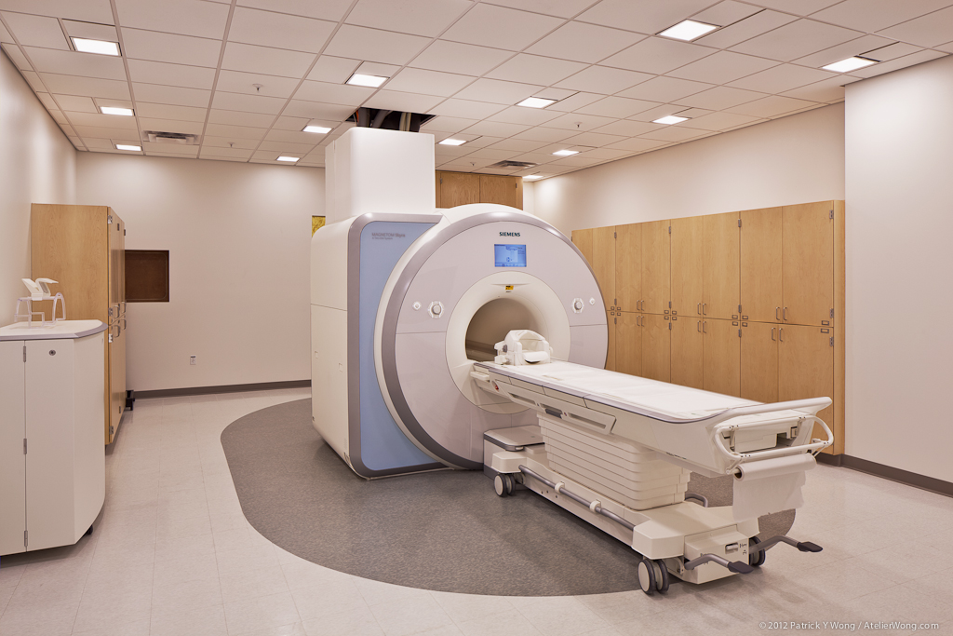
Functional Magnetic Resonance Imaging Data
Measures “BOLD” signal
Blood Oxygen Level Dependent signal
Acts as indirect proxy for brain activations
Notes:
So, in order to talk about anything involving the brain we’re going to need data. And in our lab what we collect is mostly fMRI data; that’s a picture of our scanner. And as you may be familiar with, fMRI measures the BOLD signal, which is an indirect proxy of neural activation

Slide 7
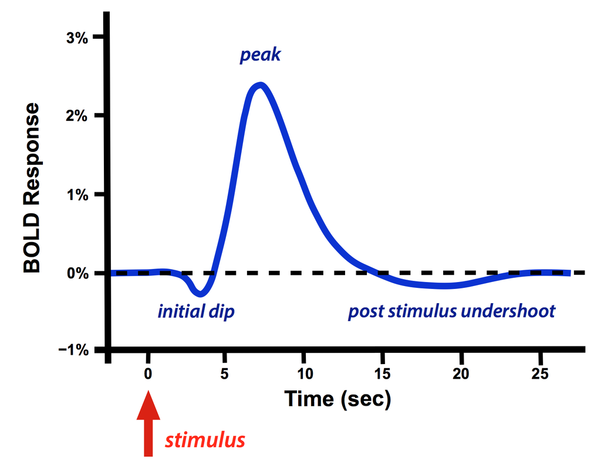
Functional Magnetic Resonance Imaging Data
Measures “BOLD” signal
Blood Oxygen Level Dependent signal
Acts as indirect proxy for brain activations
Temporal Resolution: About 2 seconds
Temporal lag of about 8 seconds
Notes:
And it does this with a relatively poor temporal resolution compared to other methods like EEG

Slide 8
Functional Magnetic Resonance Imaging Data
Measures “BOLD” signal
Blood Oxygen Level Dependent signal
Acts as indirect proxy for brain activations
Temporal Resolution: About 2 seconds
Temporal lag of about 8 seconds
Spatial Resolution: 17mm^3 “voxels” (About 90K per brain)
Notes:
But it has a relatively good spatial resolution of about 17 cubic millimeters per voxel, which is the main reason we use it.

Slide 9
Functional Magnetic Resonance Imaging Data
Measures “BOLD” signal
Blood Oxygen Level Dependent signal
Acts as indirect proxy for brain activations
Temporal Resolution: About 2 seconds
Temporal lag of about 8 seconds
Spatial Resolution: 17mm^3 “voxels” (About 90K per brain)
Scan subjects while listening to natural language podcasts
3 subjects, 20 hours of podcast data each
Notes:
And since we’re interested in how brains process language, we have subjects listen to natural language stories from podcasts and other auditory media while they’re in the scanner. So the data we used for most of the research I’m about to present was from 3 subjects, each of whom listened to 20 hours of podcasts. And this is all public data that you can use too, if you want, because we’ve put a reasonable amount of effort into open-sourcing it.

Slide 10
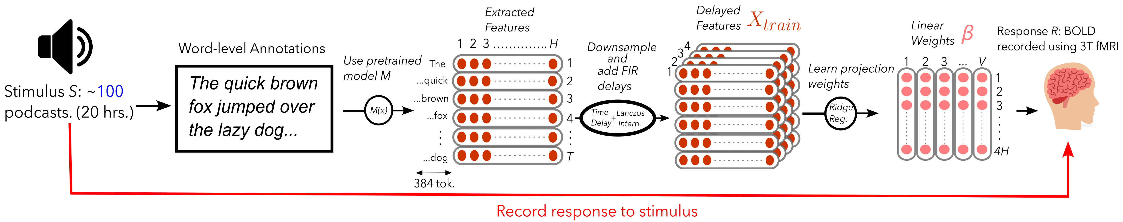
Language Encoding Models
Notes:
And the way we typically study this data is through the use of language encoding models. And these are models that attempt to predict what the voxelwise response to a given language stimulus will be. So, how this works, is we have our stimulus data which as I mentioned a moment ago is about 20 hours of podcast data.

Slide 11
Language Encoding Models
Notes:
And we first start this process by transcribing this audio into words by annotating each word with a label of what it is and at what time it occurred.

Slide 12
Language Encoding Models
Notes:
Then we feed this transcript through an embedding model M, and this can be just about anything that extracts features from text.

Slide 13
Language Encoding Models
Notes:
And next we downsample these features to align temporally with our fMRI data, which as I said has a temporal resolution of about 2 seconds, so much slower than typical spoken word rate, and we add FIR delays to model the hemodynamic response in BOLD.

Slide 14
Language Encoding Models
Notes:
And then finally we learn through ridge regression, some set of linear weights, beta, that when multiplied by these time-delayed, downsampled features

Slide 15
Language Encoding Models
Notes:
produces a prediction of voxelwise BOLD response, and so in the end we are just using our paired stimulus-response data to learn this set of linear weights

Slide 16
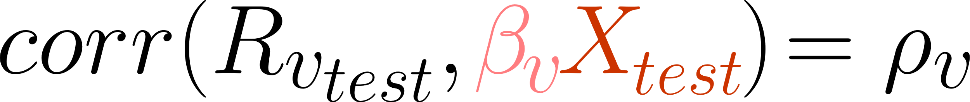
Language Encoding Models
Evaluate model performance on correlation with ground truth
Notes:
And then finally we can evaluate the performance of our model on some held-out data, and so when I refer to encoding performance elsewhere in this talk, I typically just mean the correlation of our prediction with the ground truth measurements in our test set

Slide 17
Outline
Why do LM-based encoding models work?
What is the underlying reason why some representations work better for encoding than others? ¹
How can we improve encoding models to make them more powerful?
Model Scaling ²
Building Nonlinear Encoding Models³
What are the downstream applications of powerful encoding models?
Improved Bayesian Semantic Decoding³
Interpretable modulation of brain voxels through natural language³
¹“Predictive Coding or Just Feature Discovery?”, Antonello and Huth, Neurobiology of Language, 2022
²“Scaling Laws of Language Encoding Models in fMRI”, Antonello, et al., NeurIPS, 2023
³Manuscript(s) in prep., Antonello et al., (2024?)
Notes:
So, in this talk I’ll be presenting some of my work on a couple of papers I’ve published in the past as well as some newer unpublished work which I’m really excited to get your opinions on. Like I said, the focus of my research is with encoding models, so all of this work in encoding model adjacent. This talk is separated into three parts.

Slide 18
Outline
Why do LM-based encoding models work?
What is the underlying reason why some representations work better for encoding than others? ¹
How can we improve encoding models to make them more powerful?
Model Scaling ²
Building Nonlinear Encoding Models³
What are the downstream applications of powerful encoding models?
Improved Bayesian Semantic Decoding³
Interpretable modulation of brain voxels through natural language³
¹“Predictive Coding or Just Feature Discovery?”, Antonello and Huth, Neurobiology of Language, 2022
²“Scaling Laws of Language Encoding Models in fMRI”, Antonello, et al., NeurIPS, 2023
³Manuscript(s) in prep., Antonello et al., (2024?)
Notes:
In the first part I’ll be talking about some of the work I did on a paper that was focused on trying to understand what it is about a language models that makes them so potent at modeling brain activity. And in that I’ll present what I think the major hypotheses here are and make a case for my point of view on this subject.

Slide 19
Outline
Why do LM-based encoding models work?
What is the underlying reason why some representations work better for encoding than others? ¹
How can we improve encoding models to make them more powerful?
Model Scaling ²
Building Nonlinear Encoding Models³
What are the downstream applications of powerful encoding models?
Improved Bayesian Semantic Decoding³
Interpretable modulation of brain voxels through natural language³
¹“Predictive Coding or Just Feature Discovery?”, Antonello and Huth, Neurobiology of Language, 2022
²“Scaling Laws of Language Encoding Models in fMRI”, Antonello, et al., NeurIPS, 2023
³Manuscript(s) in prep., Antonello et al., (2024?)
Notes:
And following that, we’ll move on to the second portion of the talk, which will focus on how we can make existing encoding models better, in part by utilizing the ideas from part 1 of the talk and by changing how we train encoding models.

Slide 20
Outline
Why do LM-based encoding models work?
What is the underlying reason why some representations work better for encoding than others? ¹
How can we improve encoding models to make them more powerful?
Model Scaling ²
Building Nonlinear Encoding Models³
What are the downstream applications of powerful encoding models?
Improved Bayesian Semantic Decoding³
Interpretable modulation of brain voxels through natural language³
¹“Predictive Coding or Just Feature Discovery?”, Antonello and Huth, Neurobiology of Language, 2022
²“Scaling Laws of Language Encoding Models in fMRI”, Antonello, et al., NeurIPS, 2023
³Manuscript(s) in prep., Antonello et al., (2024?)
Notes:
And lastly, in the final part of the talk, I’ll be discussing what exactly we can do with these new, more powerful encoding models, so, enumerating some practical applications of these models. And I’ll be doing that with two examples from upcoming work of mine that demonstrates the impact here – showing that more powerful encoding models leads to more powerful decoding models, and separately that we can use these models to unlock new interpretability tools for understanding more fine-grained elements of language processing in the brain.

Slide 21
Perplexity as a Predictor of Encoding Model Performance
Encoding quality has evolved with improvements in NLP algorithms
Notes:
So as I mentioned, the first topic I’ll be discussing is this question of why representations from language models are good at predicting brain activity. And here its useful to note that over the past ten years, encoding models have evolved alongside larger trends in NLP research.

Slide 22
Perplexity as a Predictor of Encoding Model Performance
Encoding quality has evolved with improvements in NLP algorithms
Word embedding encoding models (2014-2017)
Notes:
Building encoding models with hand-crafted features has existed for several decades, but the trend of adapting representations from NLP literature really began with the use of word embedding models in the mid 2010s

Slide 23
Perplexity as a Predictor of Encoding Model Performance
Encoding quality has evolved with improvements in NLP algorithms
Word embedding encoding models (2014-2017)
RNN/LSTM encoding models (2018-2019)
Notes:
This evolved to using RNN and LSTM models when researchers recognized that it was useful to not only embed the lexical features of the stimulus but also compositional and contextual features of the stimulus as well.

Slide 24
Perplexity as a Predictor of Encoding Model Performance
Encoding quality has evolved with improvements in NLP algorithms
Word embedding encoding models (2014-2017)
RNN/LSTM encoding models (2018-2019)
Transformer and LLM encoding models (2020-present)
Notes:
And the current iteration of this approach is to extract representations from the functions learned by large Transformer language models which is considered the state-of-the-art in the wider NLP world for many other applications as well.

Slide 25
Perplexity as a Predictor of Encoding Model Performance
Encoding quality has evolved with improvements in NLP algorithms
Word embedding encoding models (2014-2017)
RNN/LSTM encoding models (2018-2019)
Transformer and LLM encoding models (2020-present)
Improved Performance
Notes:
So from a larger perspective, there’s been this overall trend that what’s good for the modeling brain activity has closely aligned with what’s good for the general AI research community.

Slide 26
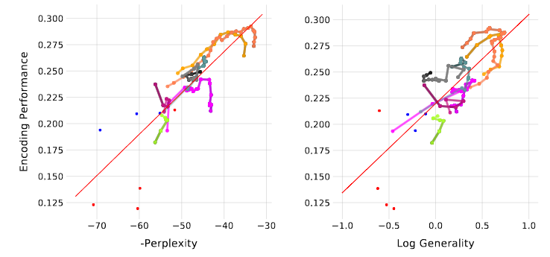
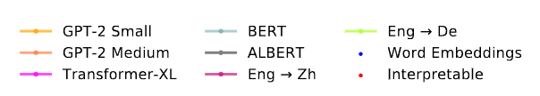
Perplexity as a Predictor of Encoding Model Performance
Encoding quality has evolved with improvements in NLP algorithms
Word embedding encoding models (2014-2017)
RNN/LSTM encoding models (2018-2019)
Transformer and LLM encoding models (2020-present)
Models with lower perplexity are typically better for encoding
Improved Performance
“The neural architecture of language: Integrative modeling converges on predictive processing”, PNAS, Schrimpf et al., 2021
“Shared computational principles for language processing in humans and deep language models”, Nature Neuroscience, Goldstein et al., 2022
“Evidence of a predictive coding hierarchy in the human brain listening to speech” Nature Human Behavior, Caucheteux et al., 2023
Notes:
And this serves to motivate the first insight that people really had into this problem, which is that there’s this strong relationship between a representation’s encoding performance and its ability to predict future words or sentences in an autoregressive context. So what I’m showing here is a reproduction I made of this result, where I’ve plotted a number of representations with their negative perplexity against a measure of encoding performance, and we can see a strong relationship between the two, so as perplexity decreases, encoding performance increases. And, uh, we weren’t the first people to notice this, like I said this is a replication, and there were several groups that made this observation earlier. such as yourselves. So clearly a strong result, and something that we would like to have a good explanation for, especially since this is something that is happening somewhat organically, none of the researchers that are building these models are explicitly trying to make better models of the brain, its just a sort of byproduct of their actual goal of building better language models.

Slide 27
Predictive Coding or Feature Discovery?
Two worlds:
Notes:
So the way I see it, there are two perspectives on how this relationship might arise. In either case we are performing the same intervention on the model, which is that we are reducing the perplexity of the final token output probabilities of the model through backpropagation.

Slide 28
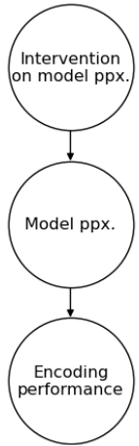
Predictive Coding or Feature Discovery?
Two worlds:
Notes:
So in this first scenario, there really is a fundamental causal link binding the perplexity of a representation to its encoding performance. This can justified in a few ways, but I think the most prominent goes something like this: the brain has some prediction objective, not unlike the models we are training And so when you decrease the perplexity of a model, you are necessarily going to increase the encoding performance of the model’s representations, because we are now more closely aligned with the objectives of the two systems, the models and the brain.

Slide 29
Predictive Coding or Feature Discovery?
Two worlds:
“Predictive
Coding Hypothesis”
Notes:
So we can call this world the Predictive Coding Hypothesis, because it aligns closely with work that has suggested that prediction is a fundamental mechanism that the brain uses to learn. And many groups have written papers advocating for this view, such as the papers that I had written on the previous slide.

Slide 30
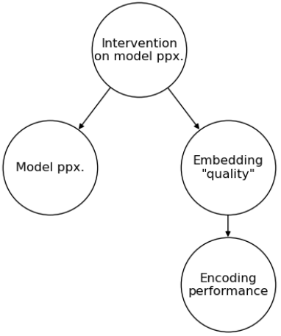
Predictive Coding or Feature Discovery?
Two worlds:
“Predictive
Coding Hypothesis”
Notes:
And the second world, which is my view, is a bit more complicated, goes something like this. When we perform this intervention on model perplexity through backpropagation, we also happen to change something else, which I’m going to nebulously refer to for now as embedding quality, and its this thing, this “embedding quality” that’s actually causing the improvement in encoding performance. The argument here is that there’s nothing inherently important about autoregression for predicting brain responses, and that our intervention on model perplexity is just one of many potentially valid ways of learning about the structure of language and how to embed it in an effective way.

Slide 31
Predictive Coding or Feature Discovery?
Two worlds:
“Predictive
Coding Hypothesis”
“Useful
Embedding Hypothesis”
Notes:
And so for the sake of this talk, we’ll call this theory the useful embedding hypothesis.

Slide 32

Predictive Coding or Feature Discovery?
Two worlds:
“Predictive
Coding Hypothesis”
“Useful
Embedding Hypothesis”
Notes:
And just to give some motivation for why we might believe in this hypothesis rather than the other one, we can use an analogy to a task that is better understood than encoding, so, for example, dependency parsing. It turns out that if you finetune a simple model on top of the representations from a language model you can learn to do dependency parsing rather well. But its pretty clear that dependency parsing doesn’t really have anything do to with prediction, except that in the course of learning how to predict well, it is necessary as a stepping stone to learn how to do dependency parsing well.

Slide 33
Generality as a Predictor of Encoding Model Performance
Generality
An embedding is more general if it transfers well to many other language representations.
Notes:
So in order to make the case for this Useful Embedding Hypothesis, we wanted to make some kind of metric for the “quality” of a embedding. And for this we arrived at the generality metric. What this metric measures is the average propensity of a given embedding or representation to transfer to well to many other representations. So for a bunch of these representations, we borrowed a method from computer vision literature that essentially allowed us to fairly compute these transfer properties between a variety of different representations and then we just averaged them to get a single number.

Slide 34
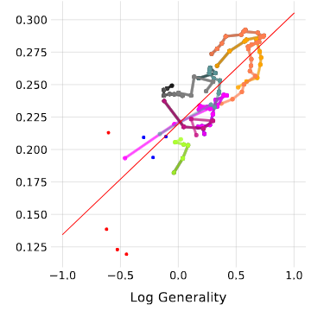
Generality as a Predictor of Encoding Model Performance
Generality
An embedding is more general if it transfers well to many other language representations.
Works comparably to perplexity as a predictor of encoding model performance
Notes:
And so what we found was that this metric was comparable to perplexity as a predictor of encoding performance, not only between models but also within representations coming from the same model. So here, as in the perplexity plot I showed earlier, we’ve plotted this generality metric against encoding performance and its very clear that there’s a high correspondence between these two metrics. And incidentally, the correlation is actually slightly stronger, but not significantly so. So we can at the very least claim that this hypothesis has just as much evidence as the other one.

Slide 35
Translation as a Predictor of Encoding Model Performance
Eng->De Translation Performance
A representation has a higher translation performance if it can transfer better to a representation from an English -> German model.
Notes:
And finally, we created one last metric in this study, which I’m going to call English to German translation performance. And this metric is defined as the propensity of a representation to transfer well to a representation from an English to German machine translation model. And we included this final metric not so much to make any specific claims about the nature of computation in the brain but instead in order to make a broader point about the validity of these types of arguments that relate encoding performance to metrics like perplexity and generality.

Slide 36
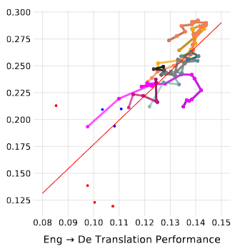
Translation as a Predictor of Encoding Model Performance
Eng->De Translation Performance
A representation has a higher translation performance if it can transfer better to a representation from an English -> German model.
Notes:
What we found was that this metric also correlated well with encoding performance, not as well as either of the metrics I just presented, but far above any reasonable significance threshold. And the main point here is that, uh, if we uncritically applied this same logic to this correlation, we might falsely conclude that English to German translation is fundamentally tied up in the nature of how the brain works. Obviously, that’s not the case. What’s really happening here is almost surely something like the dependency parsing example, where there is this tendency for models that are good for one sufficiently general task, like prediction or encoding, to be good for many others, like translation. And I think that this result, puts a little bit of an asterisk over the rest of the results I just presented, and it just underscores that the jury is still out on this larger problem of what exactly is driving these improvements in encoding performance.

Slide 37
Outline
Why do LM-based encoding models work?
What is the underlying reason why some representations work better for encoding than others? ¹
How can we improve encoding models to make them more powerful?
Model Scaling ²
Building Nonlinear Encoding Models³
What are the downstream applications of powerful encoding models?
Improved Bayesian Semantic Decoding³
Interpretable modulation of brain voxels through natural language³
¹“Predictive Coding or Just Feature Discovery?”, Antonello and Huth, Neurobiology of Language, 2022
²“Scaling Laws of Language Encoding Models in fMRI”, Antonello, et al., NeurIPS, 2023
³Manuscript(s) in prep., Antonello et al., (2024?)
Notes:
So that will conclude the first part of this talk, and I’m happy to answer questions now if people have any. Ok, so now we’ll be moving from this question of why language models work for encoding and on to the related question of how we as academics can work to further improve these models. And for this topic I’ll be discussing two approaches that I’ve been focusing on for this, which are encoding model scaling and learning nonlinear encoding models.

Slide 38
Scaling Laws in LLMs
Scaling Law – Relationship between used model resources and performance
Notes:
So scaling is something that has been well-understood as a powerful tool for improving LLMs for several years now, and its been this scaling, more than anything else, that has driven the majority of the improvements from earlier language models like GPT-2 to more powerful LLMs like today’s GPT-4. This has become such a well known phenomenon that there’s even a term for the mathematical relationships between model size and model performance and that is the notion of “scaling laws”.

Slide 39
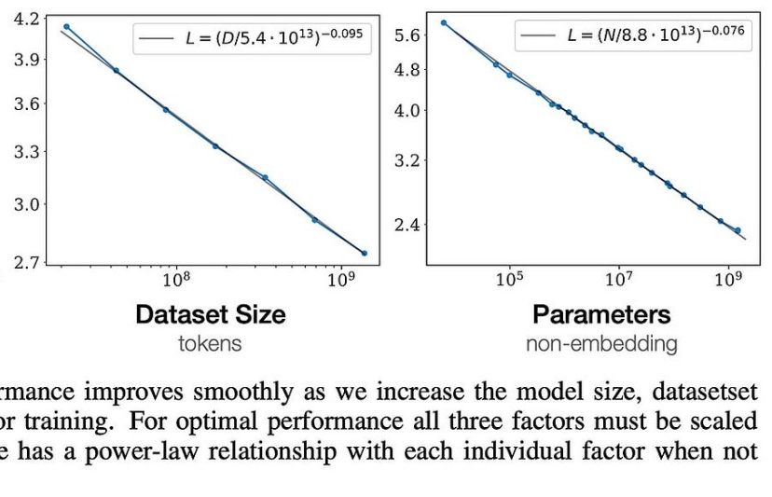

Scaling Laws in LLMs
Scaling Law – Relationship between used model resources and performance
Demonstrated power law scaling for dataset size and LLM parameters
“Training Compute-Optimal Large Language Models”, Hoffmann et al., arXiv:2203.15556, 2022
Notes:
So one of the earliest works to investigate scaling laws was the Chinchilla scaling laws paper, and in that work they did a pretty complete parameter search that demonstrated that language modelling test perplexity decreases in a power law relationship to the other metrics such as number of parameters and dataset size. So these are classic examples of scaling laws, and it’s natural to wonder if the same scaling holds true in encoding models.

Slide 40
Scaling Laws of Encoding Models
Tested models of sizes 125M to 175B, controlling for architecture/hyperparameters
Dataset sizes from ~10 minutes to 20 hours
Notes:
So, um, that’s the question we set out to answer in this paper, where we examined the relationships between model size, dataset size, and encoding performance. What we did here was train encoding models using different sizes of models from the same model family, so we were able to control for other things that might have an impact on encoding performance like choice of architecture, hyperparameters, and training dataset. We tested models in the OPT family with sizes of 125M parameters all the way up to 175B parameters, as well as dataset sizes from 10 minutes to 20 hours.

Slide 41
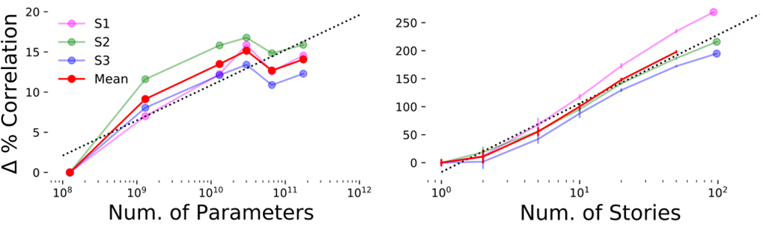
Scaling Laws of Encoding Models
Tested models of sizes 125M to 175B, controlling for architecture/hyperparameters
Dataset sizes from ~10 minutes to 20 hours
Logarithmic scaling consistent with Chinchilla scaling laws
Motivates the collection of larger datasets and scaling encoding model sizes
Notes:
So here I’m showing the main result from that paper. We found that the for encoding models, a somewhat different scaling relationship from what was demonstrated in the Chinchilla scaling laws paper applies. So these are logarithmic scaling laws. So here, when you increase the size of an embedding model multiplicatively, you get an additive improvement in encoding performance, and the same applies for dataset scaling, if you double the amount of fMRI data you train on, you get an additive increase in the overall encoding performance of the model. We view this as an important result, not just for connecting this encoding problem to advancement in AI but also in motivating the scaling up of both models and datasets in our field. And to back up this motivation, most of the remaining results that we presented in this paper were concerned with the type of predictive power that you get when you commit to scaling these models.

Slide 42
Large-Scale Encoding Models
How well can we predict voxelwise activity using available scaling approaches?
Notes:
So to do this, we asked this question of how well we could improve our encoding models if we really tried our best to maximize both of these parameters, so using as much data as possible and using the most effective model size

Slide 43
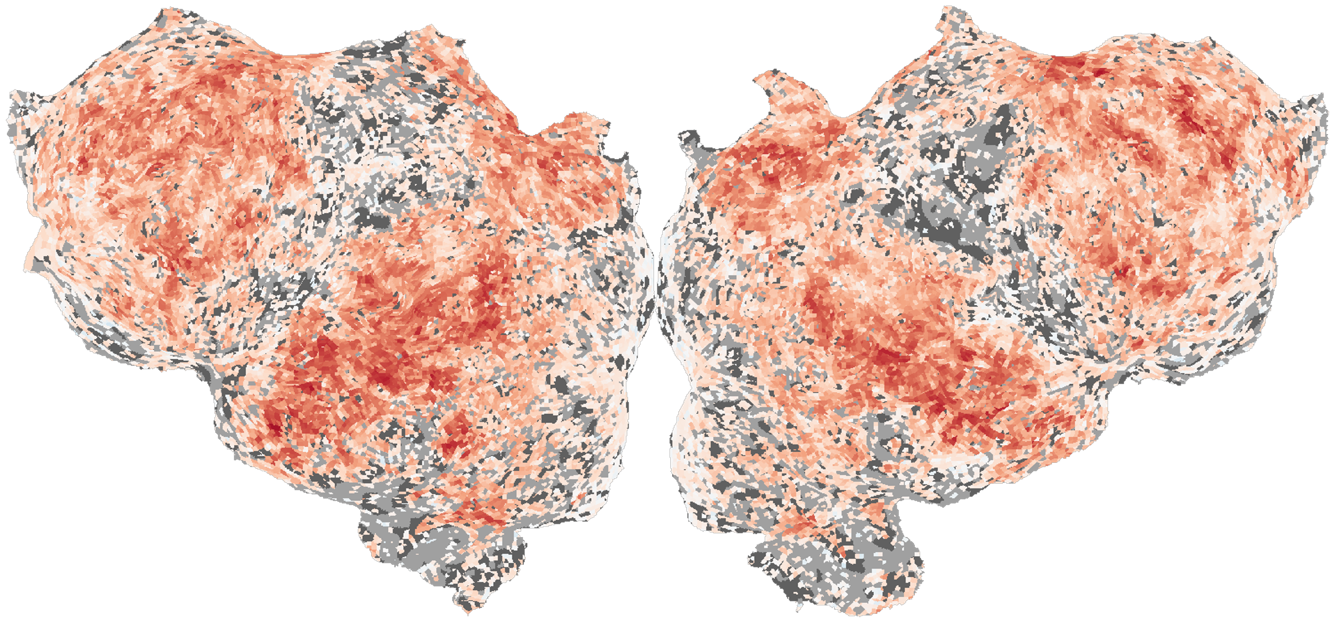
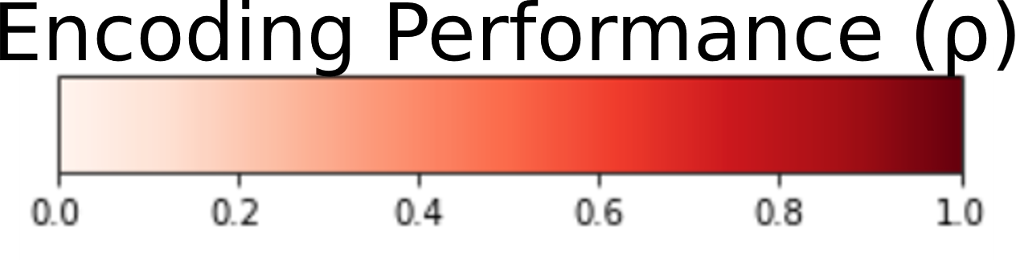
Large-Scale Encoding Models
How well can we predict voxelwise activity using available scaling approaches?
Using OPT-30B, 20 hours of single-subject paired stimulus-response data
Notes:
So this is that result. On the left we have a flatmap, so this is just a 2-dimensional representation of cortex. And I’ve colored it here so that each voxel is redder if we are able to predict the response in that voxel better on some held out test corpus. This is using OPT-30B, with 20 hours of paired stimulus-response data. And we can see that we’re able to predict, to a large degree, many of the parts of cortex that are known to be selective for language. So this includes areas like auditory cortex, precuneus, angular gyrus and prefrontal cortex, all of which are well explained by our model.

Slide 44
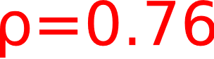
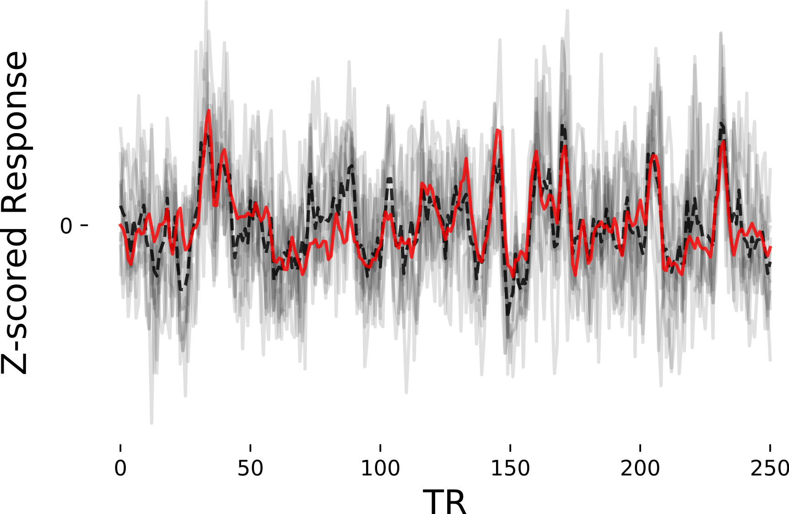
Large-Scale Encoding Models
How well can we predict voxelwise activity using available scaling approaches?
Using OPT-30B, 20 hours of single-subject paired stimulus-response data
Notes:
And on the right here, I’ve plotted the response in a single voxel taken from fusiform face area, so the area circled in blue. In light black we have the voxel responses for each of 10 repeats of this test stimulus, and in dark black is the average response over the ten test repeats. Our encoding prediction for the voxel is in bright red, and we can see that we’re able to predict this voxel pretty well. The correlation between our prediction of this voxel and the ground truth response is about 0.75 in this case, and there are many other voxels with better or similar prediction performances across cortex. So clearly this is quite powerful. And given that we have this powerful model, a natural next question is “Where is there to go from here? Can we do even better than this?”

Slide 45
Room for Improvement
Which areas of the brain have high signal but low predictability?
Where is there room for improvement of our encoding models?
Notes:
And so to try to answer that question we performed a noise ceiling analysis where we looked at which regions in the brain had high signal but low predictability, meaning that they had consistent low noise responses but that we couldn’t reliably predict those responses. So specifically, what we’re asking is where is there still room for improvement in these models.

Slide 46
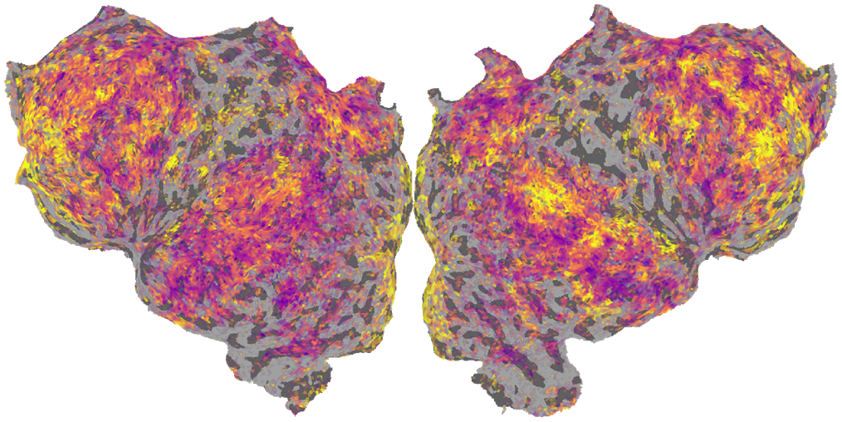
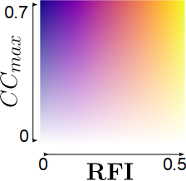
Room for Improvement
Which areas of the brain have high signal but low predictability?
Where is there room for improvement of our encoding models?
Notes:
So that is illustrated by this flatmap. This is a two-channel flatmap where a voxel is more opaque if it has a higher signal to noise ratio, and more transparent if it has a lower signal to noise ratio. And voxels in this flatmap are more purple is they have less room for improvement, meaning our prediction quality is closer to noise ceiling, whereas they are more yellow if there’s more room for improvement. So its these opaque, bright yellow voxels which are the ones that we really can’t yet explain much at all with this existing approach, and these are the voxels that future improvements to encoding models are going to have to target.

Slide 47
Room for Improvement
Which areas of the brain have high signal but low predictability?
Where is there room for improvement of our encoding models?
Lexical ROIs
Notes:
And if we look closely at this flatmap we can see that there are some general trends here. For example, regions that tend to be associated in literature with earlier, more lexical processing, like auditory cortex and precuneus, are more fully explained than regions

Slide 48
Room for Improvement
Which areas of the brain have high signal but low predictability?
Where is there room for improvement of our encoding models?
Lexical ROIs
Contextual ROIs
Notes:
That are typically considered to be more contextual or compositional, like prefrontal cortex, which is still pretty poorly explained despite having high repeatability. So what this kind of suggest is that its these same voxels that are most poorly explained that are the ones that benefit the most from these larger, more contextual models with longer context lengths, so if we want to understand these more compositional regions better, we really have to embrace scaling if we want to have any hope at modelling these regions.

Slide 49
Voxelwise Parametric Scaling Laws
Does the encoding performance of some voxels scale more than others with model size and dataset size?
Notes:
Ok, so one final result from this paper. I showed you the overall scaling trends across the brain, but that didn’t examine how these trends break down at the voxelwise level. So we can ask if the encoding performance of some voxels scales more than other with model size and dataset size.

Slide 50
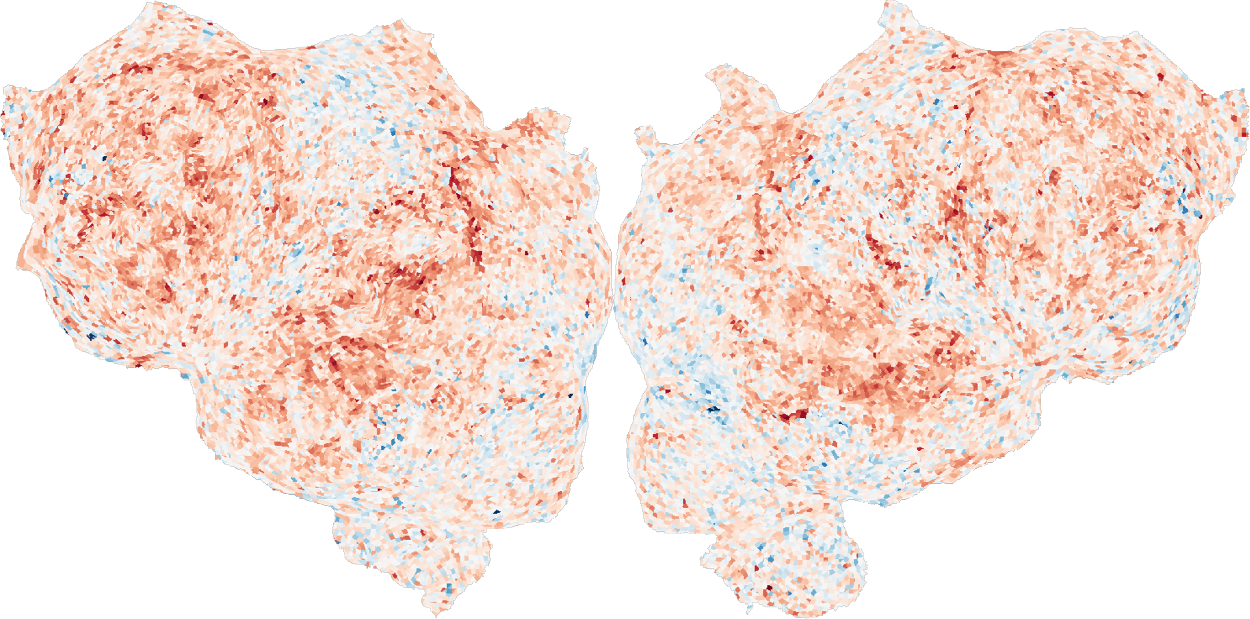
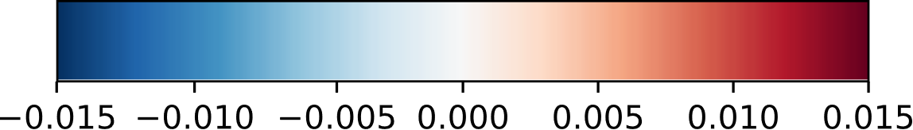
Voxelwise Parametric Scaling Laws
Does the encoding performance of some voxels scale more than others with model size and dataset size?
Parameter Scaling
Scaling Coefficient
Notes:
So here’s a flatmap exploring that question for model size. So a voxel in this flatmap is redder if encoding performance in that voxel benefits more from model size scaling. And what we see is that many of the same areas which were poorly explained by existing models are also the ones that benefit the most from scaling, particularly those larger regions in prefrontal cortex.

Slide 51
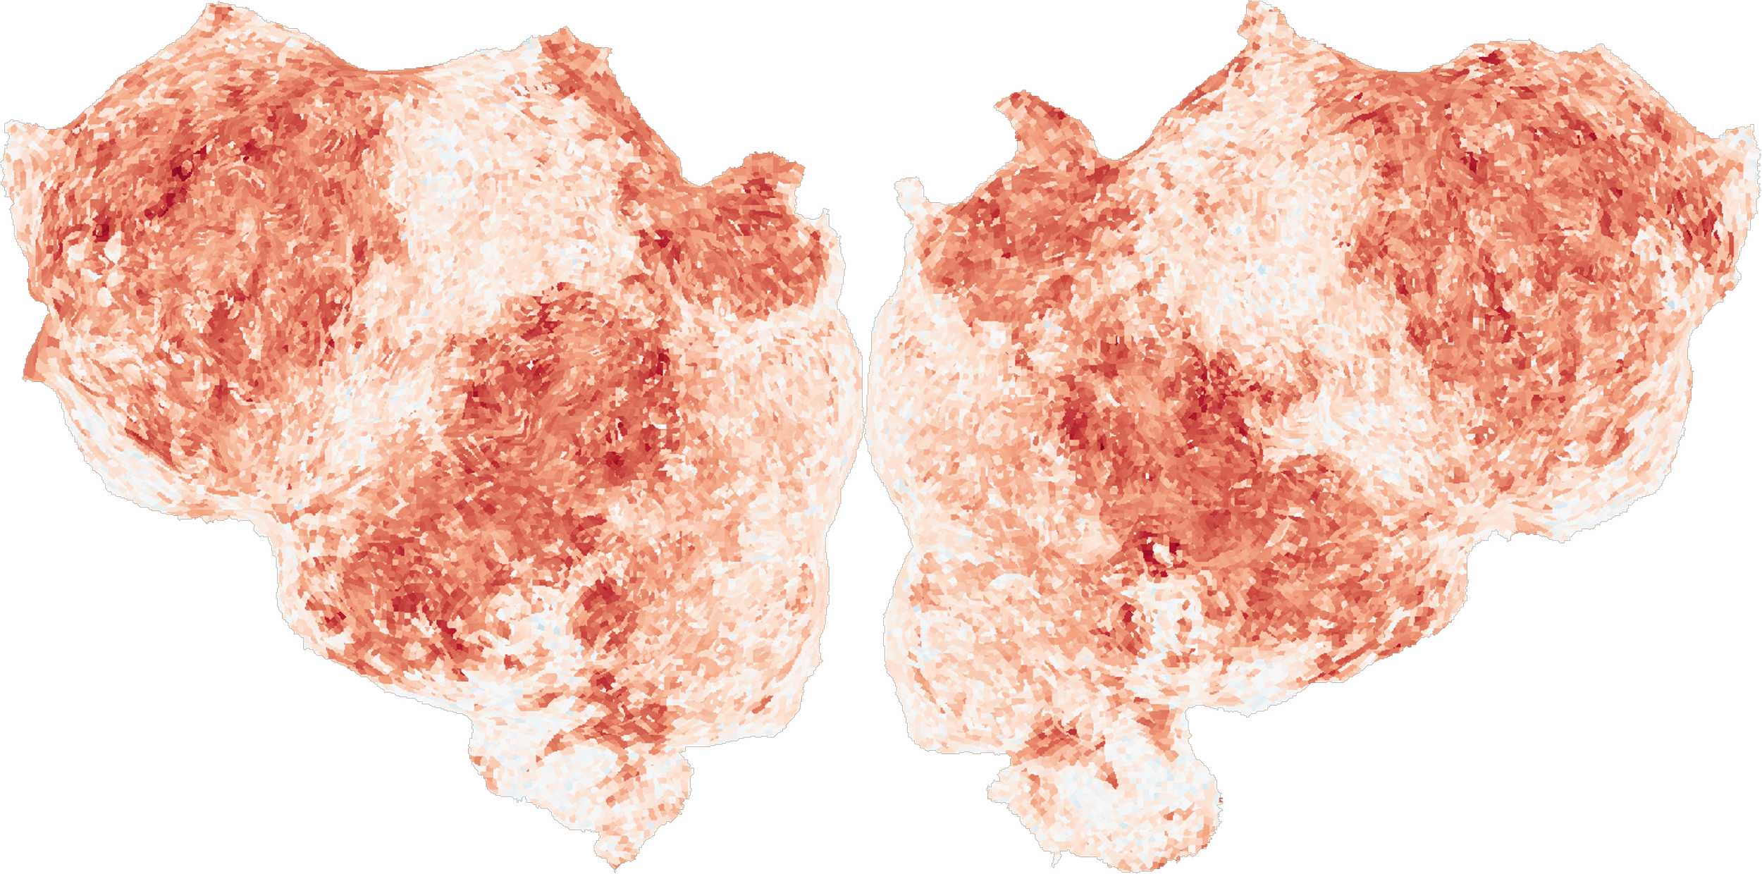
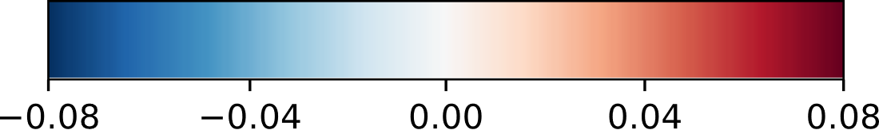
Voxelwise Parametric Scaling Laws
Does the encoding performance of some voxels scale more than others with model size and dataset size?
Parameter Scaling
Dataset Size Scaling
Scaling Coefficient
Scaling Coefficient
Notes:
And secondly this flatmap examines the scaling benefits on the dataset size axis, and here what we have is more generic, where just about any voxel that is language selective is improved when we scale up dataset size. And perhaps this last result is not too surprising, but what we hope is that this motivates other groups to expand their data collection procedures because of the clear and obvious benefits.

Slide 52
Nonlinearities in Encoding Models
Current ridge regression approaches to encoding are not expressive!
Can only learn functions that are linear in our embedding space M
But room for improvement analysis suggests there are many areas that are not linear in M
Notes:
Alright, so I’m switching to this second technique for improving language encoding models, and, uh, pretty much everything from this point on is unpublished research that’s in prep so I’m especially interested to get your feedback on this. So the second technique that I referred to earlier is learning nonlinearities for encoding models. So just to elaborate on what I mean by this. It’s clear that current ridge regression approaches to encoding models are not expressive. Since the only weights that we learn in our encoding model pipeline are the final linear projection weights from our embedding space to the voxel responses, we aren’t actually able to model any functions that are not linear in M. But clearly we’d like to be able to do this, because we want to be able to model all those brain areas that were bright yellow in the room for improvement flatmap from a few slides ago.

Slide 53
Nonlinearities in Encoding Models
Current ridge regression approaches to encoding are not expressive!
Can only learn functions that are linear in our embedding space M
But room for improvement analysis suggests there are many areas that are not linear in M
Can we learn nonlinearities using end-to-end techniques?
Notes:
So how can we learn these nonlinear functions? Well the most obvious solution which has worked so well for so many other domains is to use backpropogation to train this encoding model end-to-end. And as a practical matter, this is a relatively easy transition. So all we need to do for that is ensure this encoding model pipeline is differentiable. And it turns out that

Slide 54
Nonlinearities in Encoding Models
Current ridge regression approaches to encoding are not expressive!
Can only learn functions that are linear in our embedding space M
But room for improvement analysis suggests there are many areas that are not linear in M
Can we learn nonlinearities using end-to-end techniques?
Already a NN
Notes:
M is already a neural network

Slide 55
Nonlinearities in Encoding Models
Current ridge regression approaches to encoding are not expressive!
Can only learn functions that are linear in our embedding space M
But room for improvement analysis suggests there are many areas that are not linear in M
Can we learn nonlinearities using end-to-end techniques?
Just a
convolution
Already a NN
Notes:
Our downsampling and FIR delays can ultimately just be modelled by a convolution, and

Slide 56
Nonlinearities in Encoding Models
Current ridge regression approaches to encoding are not expressive!
Can only learn functions that are linear in our embedding space M
But room for improvement analysis suggests there are many areas that are not linear in M
Can we learn nonlinearities using end-to-end techniques?
Just a
convolution
Replaceable
with linear layer
Already a NN
Notes:
Lastly the linear projection weights that we typically learn via ridge regression can be replaced with a fully connected linear layer. So there’s nothing about this pipeline that makes it inherently challenging to backpropagate over, and we just need to slot in a few minor modifications to make it possible. So why don’t we do this?

Slide 57
Practical Data Challenges
Major challenge: Overparameterization
LMs have 100s of millions of parameters >>> number of fMRI data points
Notes:
Well, the issue with doing things the way I just described is overparameterization. If we unfreeze the weights of our embedding model M, suddenly we have hundreds of millions of free parameters in our model. And this contrasts pretty severely with the comparatively quaint 30,000 or so TRs of data that we’ve collected per subject. So obviously this is not going to fly. We’re going to have to have some solution that deals with this issue, and that’s where LoRAs come in.

Slide 58
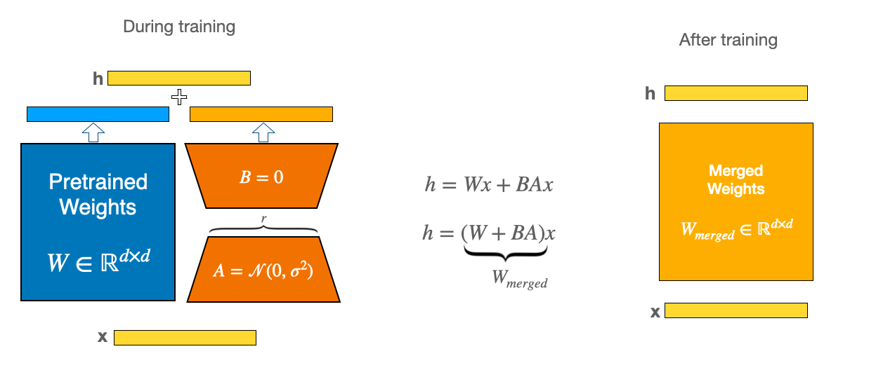
Practical Data Challenges
Major challenge: Overparameterization
LMs have 100s of millions of parameters >>> number of fMRI data points
Solution: Parameter-Efficient Finetuning (LoRAs)
“LoRA: Low Rank Adaptation of Large Language Models”, Hu et al, ICLR, 2022
Notes:
So if you aren’t familiar with LoRAs, this is a technique from finetuning literature that allows us to finetune an arbitrary neural network by augmenting each weight matrix inside it with a pair of extra weight matrices A and B, so that whenever you would use W in the original model, now you’ll be using W + BA. And the critical thing here is the A and B are low-rank, so when you decompose this down and count up the number of free parameters in this module here, instead of having, say d^2 parameters, you have 2*r*d parameters, where r is the rank of BA. So if r is much smaller than d, then you could be saving upwards of 99% of your free parameters and largely resolving this overparameterization problem.

Slide 59
BrainLoRAs
If we finetune a LoRA for encoding, can we learn new and relevant nonlinearities that improve voxelwise prediction?
Notes:
OK, so what happens if we replace our embedding model M with a LoRA version, can we learn these nonlinearities that are otherwise out of our reach?

Slide 60
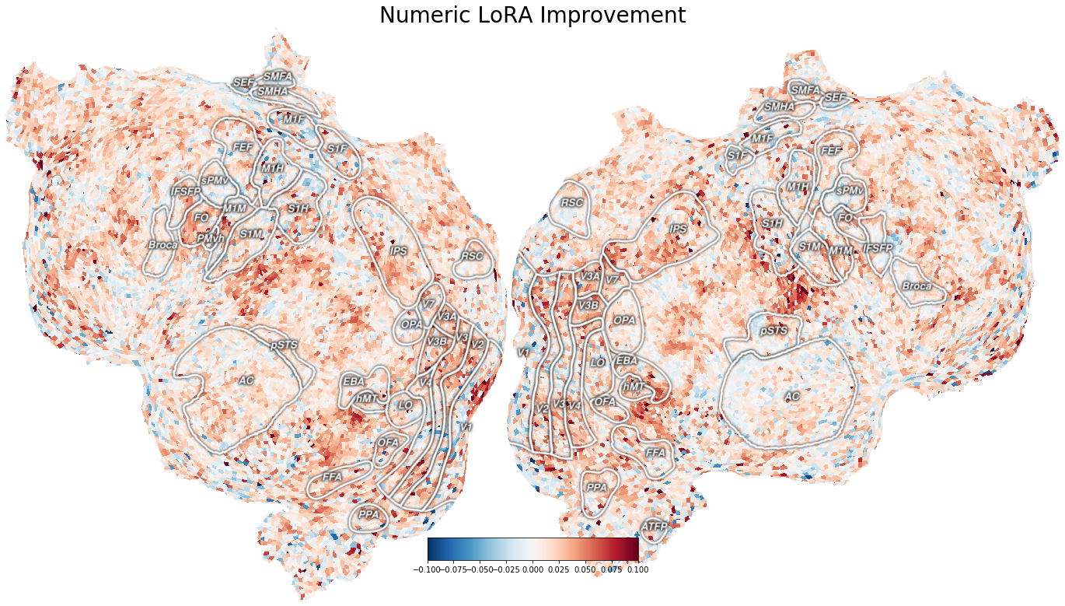
BrainLoRAs
If we finetune a LoRA for encoding, can we learn new and relevant nonlinearities that improve voxelwise prediction?
Yes! Most importantly, these nonlinear improvements largely transfer across subjects.
Encoding Improvement over Ridge
Notes:
And the answer is yes, we can do this, and yields moderate improvements in prediction performance throughout cortex. So this flatmap is just illustrating that benefit that we can get from moving from a traditional ridge regression approach to the LoRA approach. So a voxel is redder here is the benefit for this training is larger. And perhaps more importantly than this observation that we can do this, we have also observed that these improvements transfer across subjects. So if you learn these nonlinearities, all you need to do is retrain the projection layer, and you improve generally on this encoding problem in subject-agnostic way.

Slide 61
Outline
Why do LM-based encoding models work?
What is the underlying reason why some representations work better for encoding than others? ¹
How can we improve encoding models to make them more powerful?
Model Scaling ²
Building Nonlinear Encoding Models³
What are the downstream applications of powerful encoding models?
Improved Bayesian Semantic Decoding³
Interpretable modulation of brain voxels through natural language³
¹“Predictive Coding or Just Feature Discovery?”, Antonello and Huth, Neurobiology of Language, 2022
²“Scaling Laws of Language Encoding Models in fMRI”, Antonello, et al., NeurIPS, 2023
³Manuscript(s) in prep., Antonello et al., (2024?)
Notes:
Alright, so that was the second part of the talk, and I’d be happy to take questions about either of those methods at this time, or otherwise I’ll move on to the applications of these more powerful models. OK, so like I mentioned earlier I’ll be presenting two applications today, the first being imrproved Bayesian semantic decoding, and second being interpretable modulation of brain voxels through natural language

Slide 62
Bayesian Semantic Decoding Models
Semantic Decoding – Trying to infer semantics of a language stimulus using only response data.
Notes:
And for this first application I’m going to introduce this idea of Bayesian semantic decoding. So, what do I mean by semantic decoding? This is trying to infer the semantics of a language stimulus only using response data. And this contrasts somewhat from more common decoding techniques where you might try to decode mouth or hand movements from motor cortex, so we’re really trying to decode the fundamental meaning of what is being thought or heard rather than some low-level auxillary process.

Slide 63
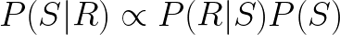
Bayesian Semantic Decoding Models
Semantic Decoding – Trying to infer semantics of a language stimulus using only response data.
Bayesian decoding inverts encoding model estimation via Bayes’ law
Notes:
And by Bayesian decoding, I simply mean that we are going to try to infer the stimulus by inverting the encoding problem of inferring the response from the stimulus using Bayes’ law.

Slide 64
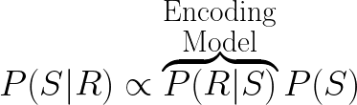
Bayesian Semantic Decoding Models
Semantic Decoding – Trying to infer semantics of a language stimulus using only response data.
Bayesian decoding inverts encoding model estimation via Bayes’ law
Notes:
So in this setup, we use a standard encoding model to estimate the probability of the response given the stimulus

Slide 65
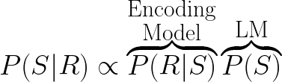
Bayesian Semantic Decoding Models
Semantic Decoding – Trying to infer semantics of a language stimulus using only response data.
Bayesian decoding inverts encoding model estimation via Bayes’ law
Notes:
Whereas we use a standard language model to propose probable stimuli

Slide 66
Bayesian Semantic Decoding Models
Semantic Decoding – Trying to infer semantics of a language stimulus using only response data.
Bayesian decoding inverts encoding model estimation via Bayes’ law
Beam Search Implementation: LM proposes continuations, encoding model evaluates them.
“Semantic reconstruction of continuous language
from non-invasive brain recordings.”,
Tang et al, Nature Neuroscience, 2023
Notes:
Now, in practice we never actually multiply these probabilities together. Instead, this is formulated as a beam search, where for each element on a beam, a language model proposes continuations, and the encoding model evaluates those continuations. And if you’re interested in reading more about this semantic decoding, our lab showed it was possible last year in some earlier work that was in Nature Neuro last year. So all together this is some semi-greedy algorithm for generating the semantics of a stimulus.

Slide 67
Improving Decoding Models
Improving our estimate of P(R|S) will naturally improve our estimate of P(S|R).
Since P(R|S) is just our encoding model, just swap out a more powerful encoding model.
Notes:
And its also pretty obvious from this formulation of the problem that improving our estimate of P(R|S) is going to improve our estimate of P(S|R). And since P(R|S) is estimated by an encoding model, all we need to do is replace this with a more powerful encoding model to see downstream improvements.

Slide 68
Improving Decoding Models
Improving our estimate of P(R|S) will naturally improve our estimate of P(S|R).
Since P(R|S) is just our encoding model, just swap out a more powerful encoding model.
Further refine algorithm with ensembling through Minimum Bayes Risk sampling
Generate a decoding that is semantically similar to many proposed decoding at once
Notes:
So for this next result that I’m about to show you, we do that, and we also introduce an ensembling technique called Minimum Bayes Risk decoding. And this is basically just centroid decoding, so we run our decoding model multiple times to get multiple decoding proposals, and then we instantiate a new beam that tries to generate an average or centroid output of all the proposals.

Slide 69
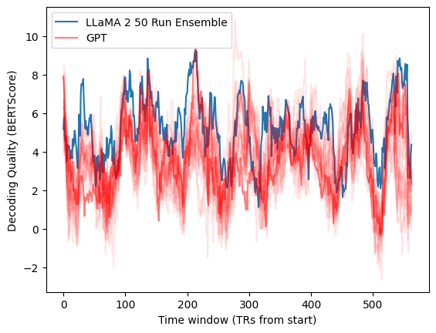
Improving Decoding Models
Improving our estimate of P(R|S) will naturally improve our estimate of P(S|R).
Since P(R|S) is just our encoding model, just swap out a more powerful encoding model.
Further refine algorithm with ensembling through Minimum Bayes Risk sampling
Generate a decoding that is semantically similar to many proposed decoding at once.
Yields about a 40% improvement over a GPT-1 baseline.
Notes:
And when we combine these two approaches, we see significant improvements in the performance of our decoding algorithm at the cost of additional compute. So this is a graph that shows the performance of our decoder over many time windows in a test story. So a higher value means that the decoded story is closer to the ground truth than a lower value, as measured by BERTScore. So in blue here is the performance of our ensembling approach, and in red several runs of our previous GPT-1 encoder without ensembling. And this results in an average of about a 40% improvement in performance, with the major caveat that this requires two to three orders of magnitude more computation. So what we see from this result is first that there’s a lot of room for improvement in this problem here, and even though what we’ve done is made some relatively minor changes here to this decoding algorithm, we can see pretty big downstream effects.

Slide 70
Qualitative Decoding Evaluation
Ground Truth: "and the person comes closer and i could see it's a woman and then i can see she has her hands in her
face oh she's crying and then she sees me and she composes herself and she gets closer and i see she
has no shoes on she has no shoes on and she's crying and she's out on the street street i recognize her"
Previous Model: 'this girl walks in and sees this guy and i notice that he is holding a cigarette in his mouth and is
making eye contact with her she immediately looks away from him and then starts crying in the corner she was
talking to me when we met in middle school i was so sad and so confused about who he was but she knew'
New Model: "guy walked in and i saw that he had his hand up the front of his shirt and he was rubbing his face
as i approached he then turned around and looked at me and started crying as he walked back to his car his head
was still down and i was very scared and confused i think it was because he didn't recognize me"
Notes:
And we can also qualitatively compare the performance of the decoders. So here’s just one example from this test story. The top line is the ground truth and then the bottom two lines are the decoded output of the earlier decoder and then the output of this new work. [Read examples] So clearly its better, the new decoder gets a lot more right on average than the old one. The reason I chose to show you this particular excerpt is because it’s the one from our test set that is most representative of the average improvement in performance between the two methods.

Slide 71
Critiques of Language Encoding Models
Notes:
So before I move on to this final application that I’m going to discuss, I wanted to first talk about some of the common criticisms that people make of encoding models and encoding model research more generally. And we’re gonna try to see if we can address these criticisms to some extent and see if we can overcome them.

Slide 72
Critiques of Language Encoding Models
The functions encoding models compute are not interpretable.
LLMs are confusing linear algebra machines, so this is prediction without explanation.
Notes:
So what are the common complaints here. Well the first, and by far the largest complaint is that standard encoding models are not especially interpretable. These LLMs that we are using for embedding models are confusing linear algebra machines that nobody can understand, so these models are fundamentally limited because they are doing prediction without explanation. It might as well be a completely black-box function because we have no idea what these things are doing. So okay, that’s one criticism what else?

Slide 73
Critiques of Language Encoding Models
The functions encoding models compute are not interpretable.
LLMs are confusing linear algebra machines, so this is prediction without explanation.
Encoding models are not inherently causal.
They don’t test clearly stated and falsifiable hypotheses.
Purely observational science that might not generalize
Notes:
A second common complaint is that encoding models research is typically observational science. So we’re bending the scientific method here a little bit in that when we do these general-purpose naturalistic experiments, we’re not really going into the experiment with an idea in mind for what we’re going to find, we’re just sort of fishing for clues. And this is a kind of loosey-goosey type of science that tends to fail to generalize when held up under the microscope, so any conclusion that we might get from studying encoding models has this huge asterisk.

Slide 74
Critiques of Language Encoding Models
The functions encoding models compute are not interpretable.
LLMs are confusing linear algebra machines, so this is prediction without explanation.
Encoding models are not inherently causal.
They don’t test clearly stated and falsifiable hypotheses.
Purely observational science that might not generalize
How do we address these criticisms?
Experiment Idea:
Notes:
Ok, so personally I think that these are pretty reasonable complaints and I would like to see if there’s some way we can address them. So I’m going to propose an experiment that addresses both of these concerns.

Slide 75
Critiques of Language Encoding Models
The functions encoding models compute are not interpretable.
LLMs are confusing linear algebra machines, so this is prediction without explanation.
Encoding models are not inherently causal.
They don’t test clearly stated and falsifiable hypotheses.
Purely observational science that might not generalize
How do we address these criticisms?
Experiment Idea:
“Search” for natural language descriptions that match the function an encoding model computes for its prediction of the response in a given voxel.
Notes:
.So in this experiment, we’re going to try to replace the linear algebra nonsense of our embedding models with easier-to-understand natural language descriptions of the functions that our encoding models compute. So to do this, we’re gonna search for natural language descriptions that match the function an encoding model computes during its prediction of the response in a given voxel.

Slide 76
Critiques of Language Encoding Models
The functions encoding models compute are not interpretable.
LLMs are confusing linear algebra machines, so this is prediction without explanation.
Encoding models are not inherently causal.
They don’t test clearly stated and falsifiable hypotheses.
Purely observational science that might not generalize
How do we address these criticisms?
Experiment Idea:
“Search” for natural language descriptions that match the function an encoding model computes for its prediction of the response in a given voxel.
Generate new stimuli using these descriptions.
Notes:
And then we’re gonna use these natural language descriptions along with the help of a large language model, to generate new stimuli that has themes that match the descriptions.

Slide 77
Critiques of Language Encoding Models
The functions encoding models compute are not interpretable.
LLMs are confusing linear algebra machines, so this is prediction without explanation.
Encoding models are not inherently causal.
They don’t test clearly stated and falsifiable hypotheses.
Purely observational science that might not generalize
How do we address these criticisms?
Experiment Idea:
“Search” for natural language descriptions that match the function an encoding model computes for its prediction of the response in a given voxel.
Generate new stimuli using these descriptions.
Test whether these new generated stimuli drive activations in the selected voxel.
Notes:
And then finally, we’re gonna test whether these new generated stimuli actually drive activations in the corresponding voxel. So does this experiment address the points above? Well, we’re replacing this hard-to-understand function that our encoding model computes with an easy-to-understand natural language description and we’re handling this causality complaint by confirming these generated hypotheses in vivo. So my claim is that this does address these points.

Slide 78
Generating Natural Language Descriptions
(i) Generate candidate descriptions for module
f
ngrams from a
reference corpus
Top-activating ngrams
Description candidates
my story is
what a great day
wow I never
….
ages of twenty
wow I never
why couldn’t
oh of course
oh what the
god i hate
wow that’s
f
This module responds to: disbelief and questioning
f
LLM
f
Summarize
f
Notes:
And the only thing that I elided there in that description is how we’re actually generating these natural language descriptions. So let me present that now. And this is going to be using a method that was developed in a earlier work by one of our coauthors over at Microsoft Research, Chandan Singh, So say we have some black-box function of a text stimulus. Let’s call it f. And let’s only assume we can evaluate f as often as we’d like on any given text input. So the idea here is very simple. First, we’re going to evaluate f, which in this case is the encoding model function we’re trying to estimate on a large and varied corpus of ngrams. Then, we’re going to select the set of ngrams that activates f the most, and we’re going to ask a language model to do the hard part here and ask it to generate a set of proposed description candidates that match those ngrams.

Slide 79

Generating Natural Language Descriptions
(i) Generate candidate descriptions for module
f
ngrams from a
reference corpus
Top-activating ngrams
Description candidates
my story is
what a great day
wow I never
….
ages of twenty
wow I never
why couldn’t
oh of course
oh what the
god i hate
wow that’s
f
This module responds to: disbelief and questioning
f
LLM
f
Summarize
f
(ii) Score candidate descriptions
Generate synthetic data
Synthetic data score
Texts⁺
Related to description
How could you?
I Can’t believe it
What do you mean!
Description candidates
This module responds to: disbelief and questioning
LLM
Maximize [ f(Text⁺) – f(Text–) ]
f
Generate
I agree
That sounds good
Nice idea
Texts–
Not related
Notes:
And then, we’re going to evaluate these generated descriptions, by having another LLM take the description and generate new ngrams that match the description. If the newly generated ngrams maximize f when compared to a control group of ngrams, we conclude that the generated description summarizes f. So all we’re doing here is asking an LLM to summarize the input/output behavior of our function and then confirming the result with a little self-contained experiment.

Slide 80
Modulating Voxels with Natural Language Explanations
Last steps:
Use generated description, along with LLM prompting, to create synthetic stories that are designed to drive activation for a given voxel
Test synthetic stories in vivo to determine efficacy
Notes:
So that experiment shows that the description for the function f is accurate, but not that the description generalizes to the brain. So to test that, all we do is use these descriptions to generate new synthetic stories that use these descriptions as motifs and we then present these stimuli to subjects to see if they drive the activation in the voxel whose function we are trying to estimate.

Slide 81
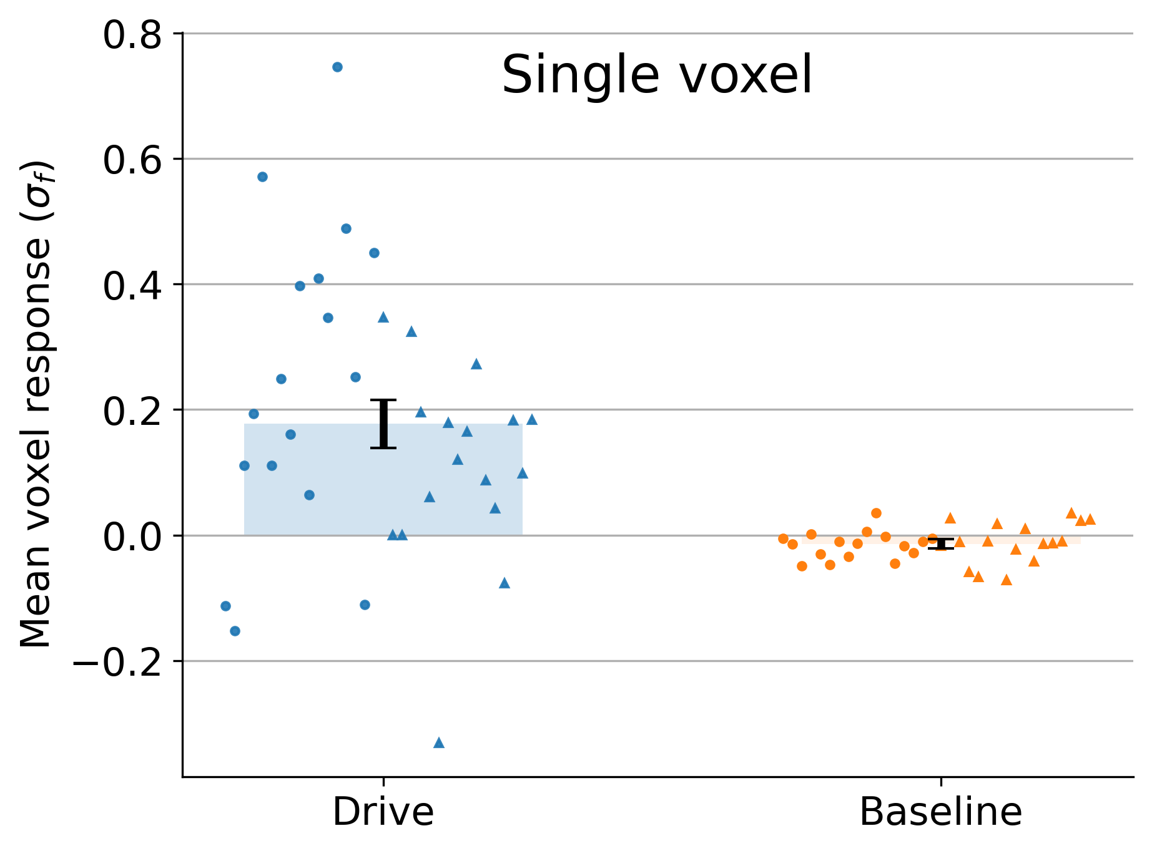

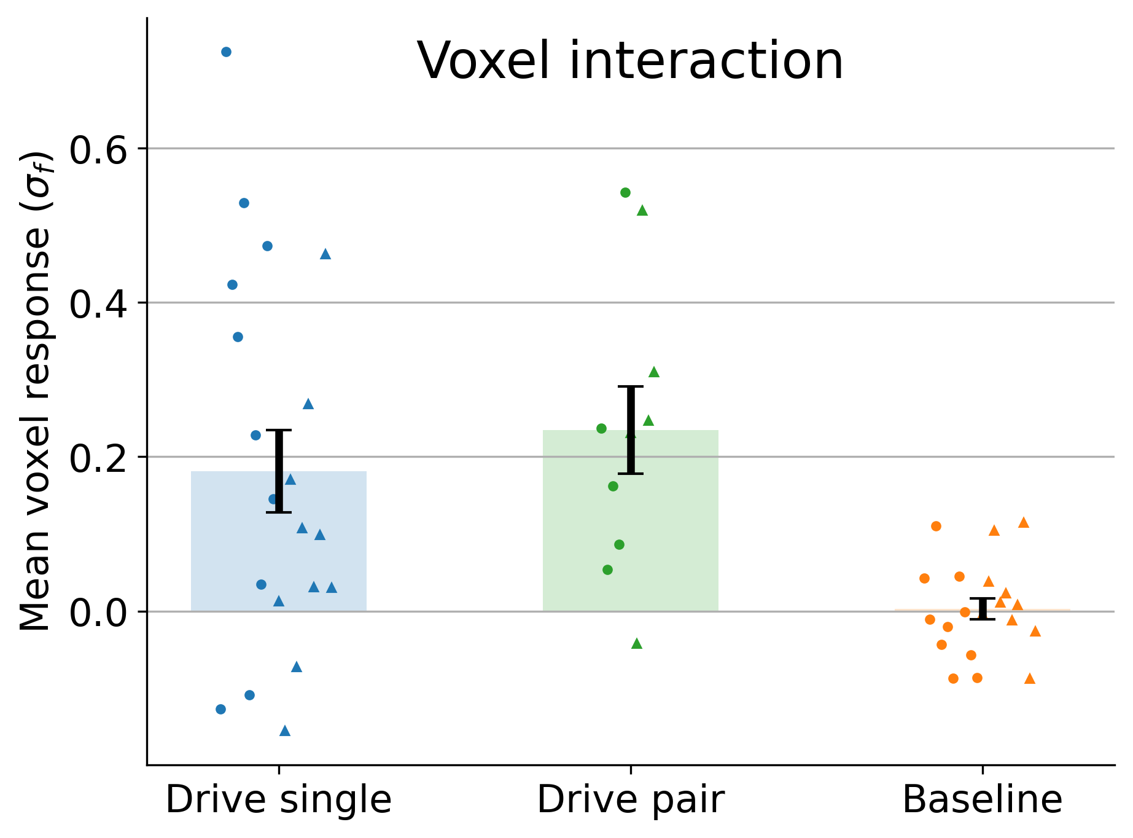
Modulating Voxels with Natural Language Explanations
Last steps:
Use generated description, along with LLM prompting, to create synthetic stories that are designed to drive activation for a given voxel
Test synthetic stories in vivo to determine efficacy
Notes:
So, very excitingly this works, and we are able to drive activations in single voxels using this approach, as well as even drive pairs of voxels as the same time by combining these generated descriptions. So what we’re demonstrating here is this fine-grained control of voxel responses through language and its done so in a way that is interpretable by normal humans, because we are forcing these descriptions to exist in this space of natural language topics. So obviously, we’re really excited about this, and we’re really interested in using this rich new field of interpretability research to benefit our understanding of encoding models, because we think that these two fields really have a lot in common.

Slide 82
Conclusions
Modern LMM-based encoding models provide unprecedented predictive power, enabling new practical applications and modes of scientific inquiry into biological language processing.
Notes:
Alright, so some final wrap-up thoughts, if you get absolutely nothing else out of this talk today. And the topline point here that I’ve been making over and over is that these new more modern LMM-based encoding models provide us with this incredibly powerful tool that is going to enable new practical applications and even new modes of scientific inquiry as you saw with that last project there.

Slide 83
Conclusions
Modern LMM-based encoding models provide unprecedented predictive power, enabling new practical applications and modes of scientific inquiry into biological language processing.
As the greater NLP research landscape continues to progress, we should continue to expect further improvements in encoding power and the expressiveness of downstream applications.
Notes:
And as the wider AI field continues to develop, we should continue to expect that this predictive power and the expressiveness of these downstream applications is only going to increase.

Slide 84
Conclusions
Modern LMM-based encoding models provide unprecedented predictive power, enabling new practical applications and modes of scientific inquiry into biological language processing.
As the greater NLP research landscape continues to progress, we should continue to expect further improvements in encoding power and the expressiveness of downstream applications.
As neuroscientists, we should work on increasing the availability of large-scale naturalistic datasets to open up newer and more expressive capabilities in neuroscience of language research.
Notes:
And, uh, finally referring to the scaling research from earlier, we as neuroscientists should prepare for all of this, by working on increasing the availability of large-scale naturalistic datasets, so that we can take full advantage of these new tools as they develop.

Slide 85






Acknowledgements
Alex Huth
Aditya Vaidya
Shailee Jain
Chandan Singh
Aliyah Hsu
Bin Yu

